Slide 1

Introduction To Object-Oriented Programming
Chapter 6 - Dictionaries

Slide 2
Dictionaries
Understanding dictionaries allows you to model a variety of real-world objects more accurately. You’ll be able to create a dictionary representing a person and then store as much information as you want about that person.
You can store their name, age, location, profession, and any other aspect of a person you can describe. You’ll be able to store any two kinds of information that can be matched up, such as a list of words and their meanings, a list of people’s names and their favorite numbers, a list of mountains and their elevations, and so forth.

Slide 3
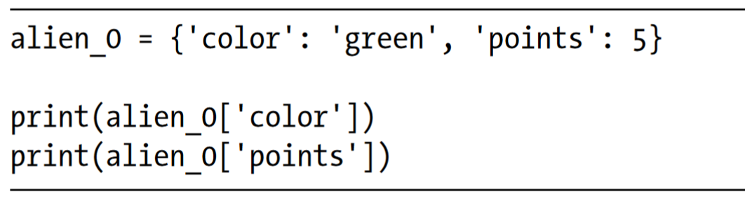
A Simple Dictionary
Consider a game featuring aliens that can have different colors and point values. This simple dictionary stores information about a particular alien:
The dictionary alien_0 stores the alien’s color and point value. The last two lines access and display that information.

Slide 4
Working with Dictionaries
A dictionary in Python is a collection of key-value pairs. Each key is connected to a value, and you can use a key to access the value associated with that key.
A key’s value can be a number, a string, a list, or even another dictionary. In fact, you can use any object that you can create in Python as a value in a dictionary.
A key-value pair is a set of values associated with each other. When you provide a key, Python returns the value associated with that key. Every key is connected to its value by a colon, and individual key-value pairs are separated by commas. You can store as many key-value pairs as you want in a dictionary.

Slide 5
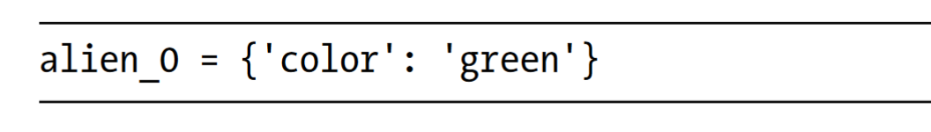
Working with Dictionaries
The simplest dictionary has exactly one key-value pair, as shown in this modified version:
This dictionary stores one piece of information about alien_0: the alien’s color. The string 'color' is a key in this dictionary, and its associated value is 'green'.

Slide 6
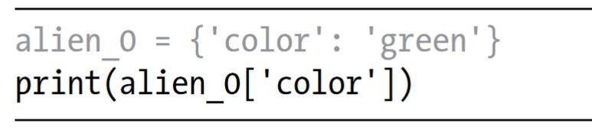
Accessing Values in a Dictionary
To get the value associated with a key, give the name of the dictionary and then place the key inside a set of square brackets.
This returns the value associated with the key 'color' from the dictionary alien_0

Slide 7
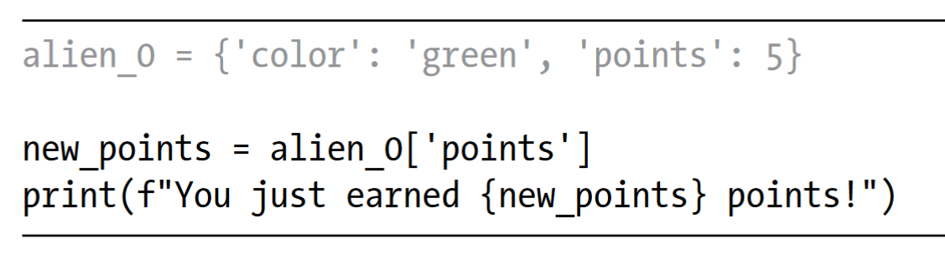
Accessing Values in a Dictionary
You can have an unlimited number of key-value pairs in a dictionary.
If a player shoots down this alien, you can look up how many points they should earn using code like this:
If you run this code every time an alien is shot down, the alien’s point value will be retrieved.

Slide 8
Adding New Key-Value Pairs
Dictionaries are dynamic structures, and you can add new key-value pairs to a dictionary at any time. To add a new key-value pair, you would give them name of the dictionary followed by the new key in square brackets, along with the new value.
Let’s add two new pieces of information to the alien_0 dictionary: the alien’s x- and y-coordinates, which will help us display the alien at a particular position on the screen.

Slide 9
Adding New Key-Value Pairs
The final version of the dictionary contains four key-value pairs. The original two specify color and point value, and two more specify the alien’s position.
As of Python 3.x, dictionaries retain the order in which they were defined. When you print a dictionary or loop through its elements, you will see the elements in the same order they were added to the dictionary.

Slide 10
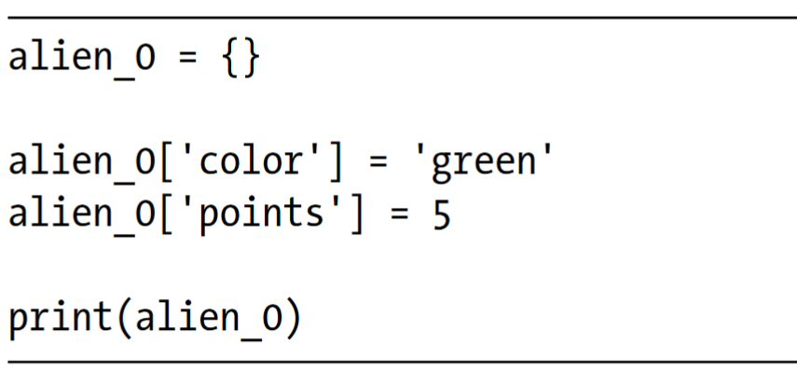
Starting with an Empty Dictionary
It’s sometimes convenient, or even necessary, to start with an empty dictionary and then add each new item to it. To start filling an empty dictionary, define a dictionary with an empty set of braces and then add each key-value pair on its own line.
Typically, you’ll use empty dictionaries when storing user-supplied data in a dictionary or when writing code that generates a large number of key-value pairs automatically.

Slide 11
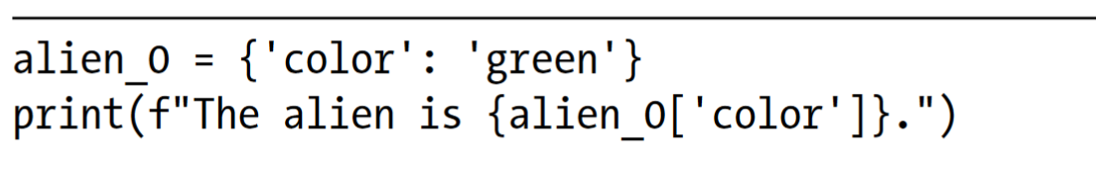
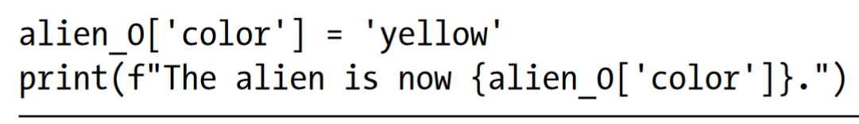
Modifying Values in a Dictionary
To modify a value in a dictionary, give the name of the dictionary with the key in square brackets and then the new value you want associated with that key.

Slide 12

Modifying Values in a Dictionary
For a more interesting example, let’s track the position of an alien that can move at different speeds. We’ll store a value representing the alien’s current speed and then use it to determine how far to the right the alien should move.

Slide 13
Modifying Values in a Dictionary
We start by defining an alien with an initial x position and y position, and a speed of 'medium'. We’ve omitted the color and point values for the sake of simplicity, but this example would work the same way if you included those key-value pairs as well. We also print the original value of x_position to see how far the alien moves to the right.
An if-elif-else chain determines how far the alien should move to the right, and assigns this value to the variable x_increment. If the alien’s speed is 'slow', it moves one unit to the right; if the speed is 'medium', it moves two units to the right; and if it’s 'fast', it moves three units to the right. Once the increment has been calculated, it’s added to the value of x_position, and the result is stored in the dictionary’s x_position.
This technique is pretty cool: by changing one value in the alien’s dictionary, you can change the overall behavior of the alien.

Slide 14
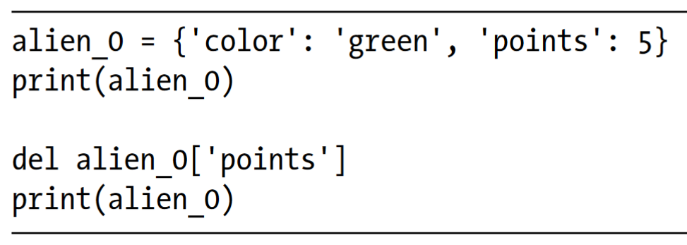
Removing Key-Value Pairs
When you no longer need a piece of information that’s stored in a dictionary, you can use the del statement to completely remove a key-value pair.
All del needs is the name of the dictionary and the key that you want to remove.

Slide 15
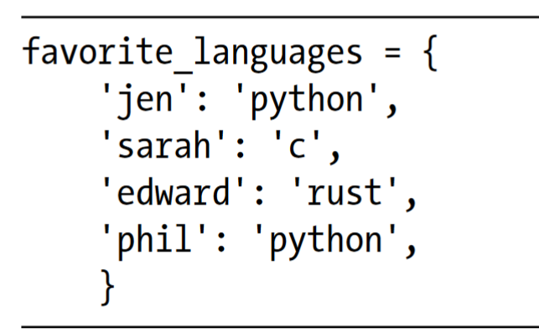
A Dictionary of Similar Objects
The previous example involved storing different kinds of information about one object, an alien in a game. You can also use a dictionary to store one kind of information about many objects.
For example, say you want to poll a number of people and ask them what their favorite programming language is. A dictionary is useful for storing the results of a simple poll.

Slide 16
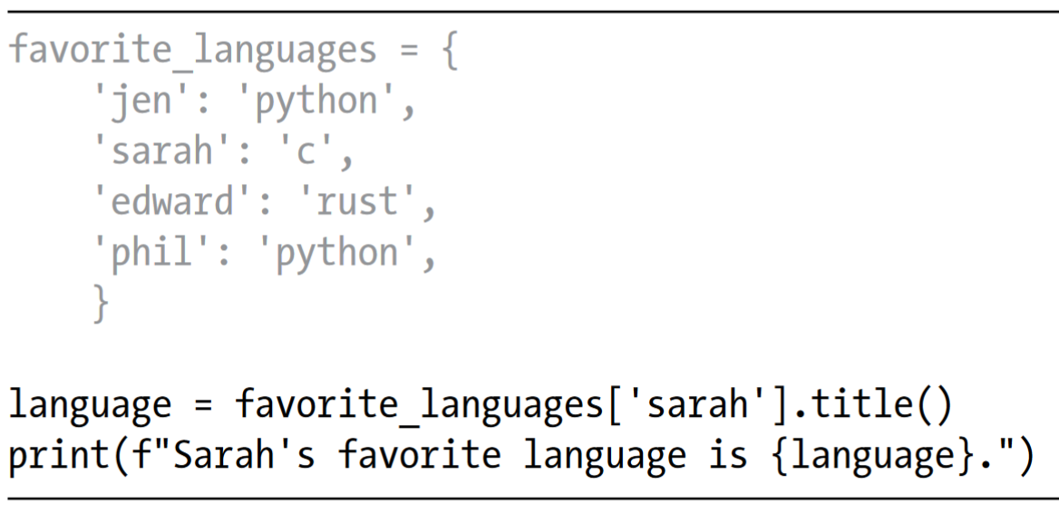
A Dictionary of Similar Objects
To use this dictionary, given the name of a person who took the poll, you can easily look up their favorite language

Slide 17
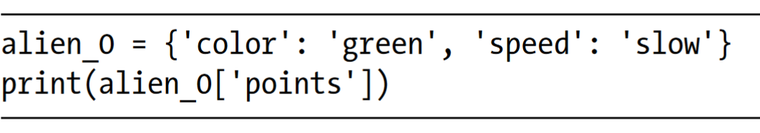
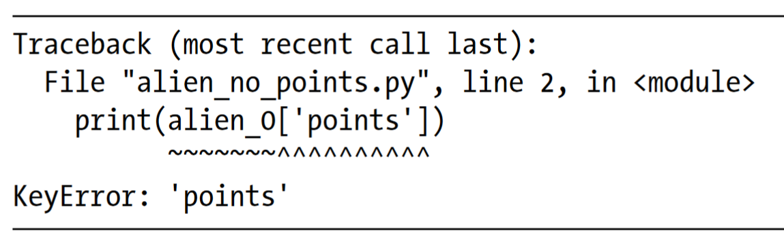
Using get() to Access Values
Using keys in square brackets to retrieve the value you’re interested in from a dictionary might cause one potential problem: if the key you ask for doesn’t exist, you’ll get an error.
Let’s see what happens when you ask for the point value of an alien that doesn’t have a point value set

Slide 18
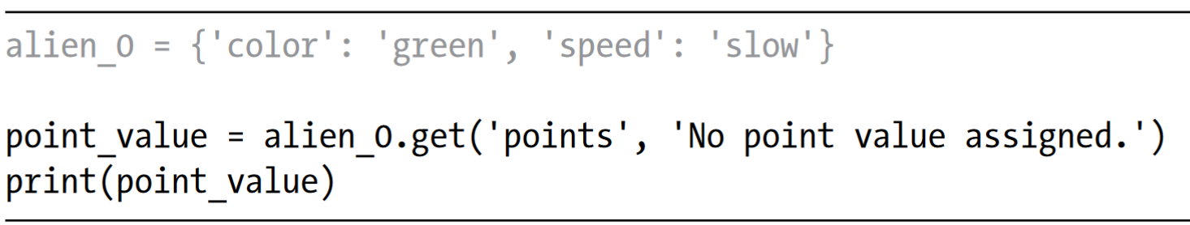
Using get() to Access Values
You’ll learn more about how to handle errors like this in general in a later chapter focusing on error handling. For dictionaries specifically, you can use the get() method to set a default value that will be returned if the requested key doesn’t exist.
The get() method requires a key as a first argument. As a second optional argument, you can pass the value to be returned if the key doesn’t exist

Slide 19

In-class Practice
Use a dictionary to store information about a person you know.
Store their first name, last name, age, and the city in which they live. You should have keys such as first_name, last_name, age, and city. Print each piece of information stored in your dictionary.

Slide 20
Looping Through a Dictionary
A single Python dictionary can contain just a few key-value pairs or millions of pairs. Because a dictionary can contain large amounts of data, Python lets you loop through a dictionary.
Dictionaries can be used to store information in a variety of ways; therefore, several different ways exist to loop through them.
You can loop through all of a dictionary’s key-value pairs, through its keys, or through its values.

Slide 21
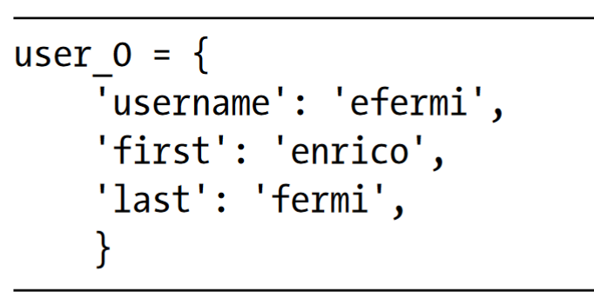
Looping Through All Key-Value Pairs
Before we explore the different approaches to looping, let’s consider a new dictionary designed to store information about a user on a website. The following dictionary would store one person’s username, first name, and last name:

Slide 22
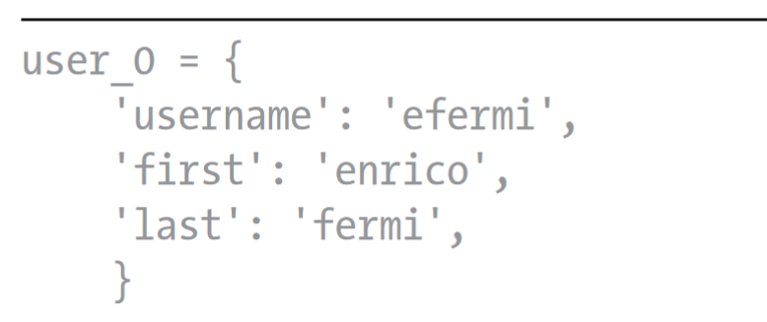
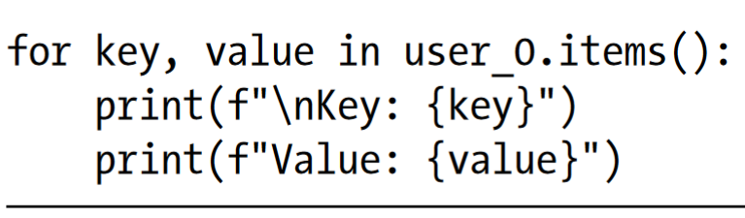
Looping Through All Key-Value Pairs
You can access any single piece of information about user_0 based on what you’ve already learned. But what if you wanted to see everything stored in this user’s dictionary? To do so, you could loop through the dictionary using a for loop:

Slide 23
Looping Through All Key-Value Pairs
To write a for loop for a dictionary, you create names for the two variables that will hold the key and value in each key-value pair. You can choose any names you want for these two variables.
The second half of the for statement includes the name of the dictionary followed by the method items(), which returns a sequence of key-value pairs.
The for loop then assigns each of these pairs to the two variables provided.

Slide 24
Looping Through All Key-Value Pairs
Looping through all key-value pairs works particularly well for dictionaries like the favorite_languages.py example, which stores the same kind of information for many different keys.
If you loop through the favorite_languages dictionary, you get the name of each person in the dictionary and their favorite programming language. Because the keys always refer to a person’s name and the value is always a language, we’ll use the variables name and language in the loop instead of key and value. This will make it easier to follow what’s happening inside the loop

Slide 25
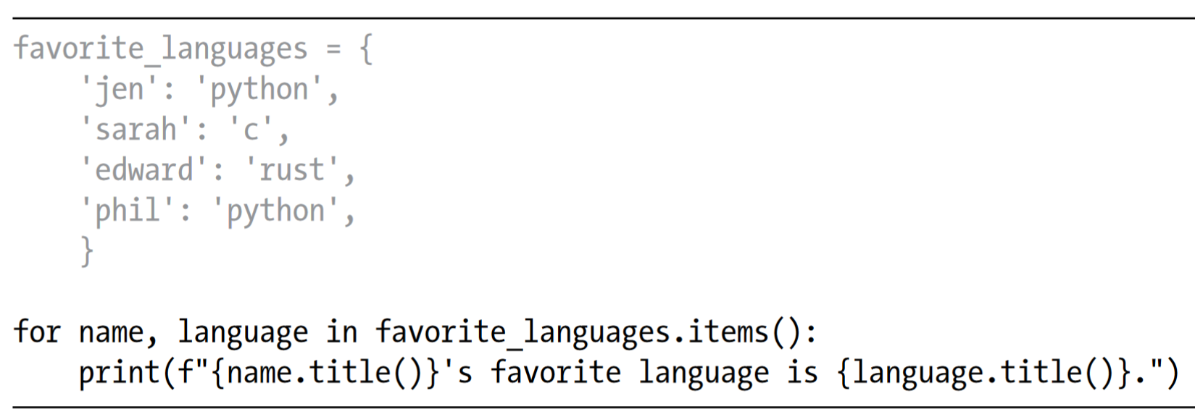
Looping Through All Key-Value Pairs
This code tells Python to loop through each key-value pair in the dictionary. As it works through each pair the key is assigned to the variable name, and the value is assigned to the variable language. These descriptive names make it much easier to see what the print() call is doing.

Slide 26
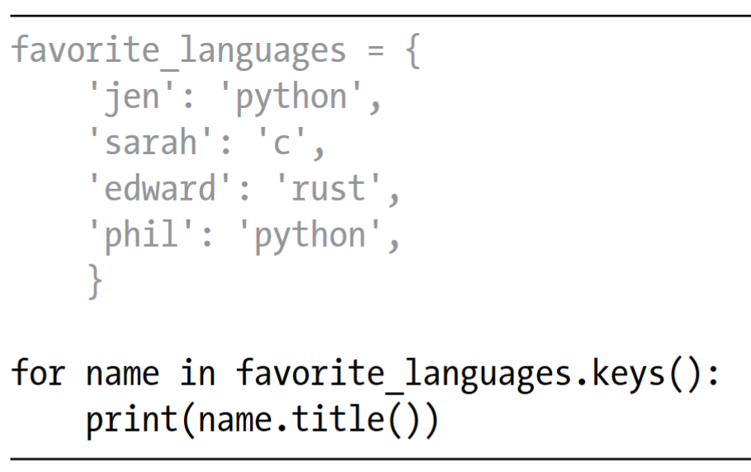
Looping Through All the Keys in a Dictionary
The keys() method is useful when you don’t need to work with all of the values in a dictionary. Let’s loop through the favorite_languages dictionary and print the names of everyone who took the poll:
This for loop tells Python to pull all the keys from the dictionary favorite_languages and assign them one at a time to the variable name. The output shows the names of everyone who took the poll

Slide 27
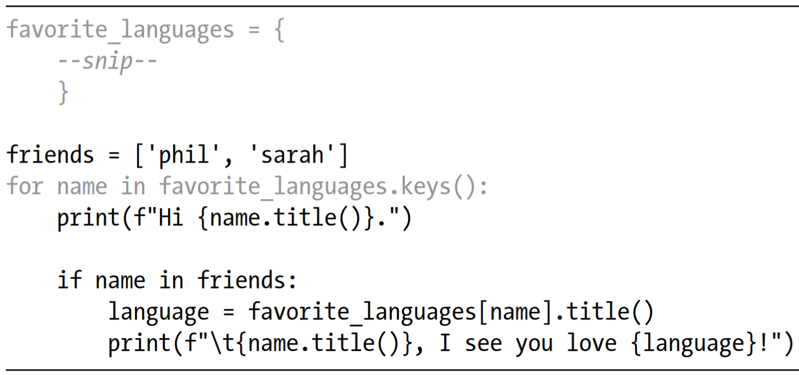
Looping Through All the Keys in a Dictionary
You can access the value associated with any key you care about inside the loop, by using the current key. Let’s print a message to a couple of friends about the languages they chose. We’ll loop through the names in the dictionary as we did previously, but when the name matches one of our friends, we’ll display a message about their favorite language.

Slide 28
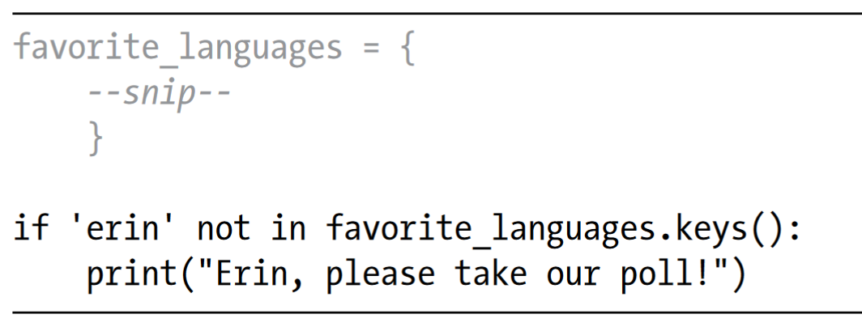
Looping Through All the Keys in a Dictionary
You can also use the keys() method to find out if a particular person was polled. This time, let’s find out if Erin took the poll:
The keys() method isn’t just for looping: it actually returns a sequence of all the keys, and the if statement simply checks if 'erin' is in this sequence. Because she’s not, a message is printed inviting her to take the poll

Slide 29
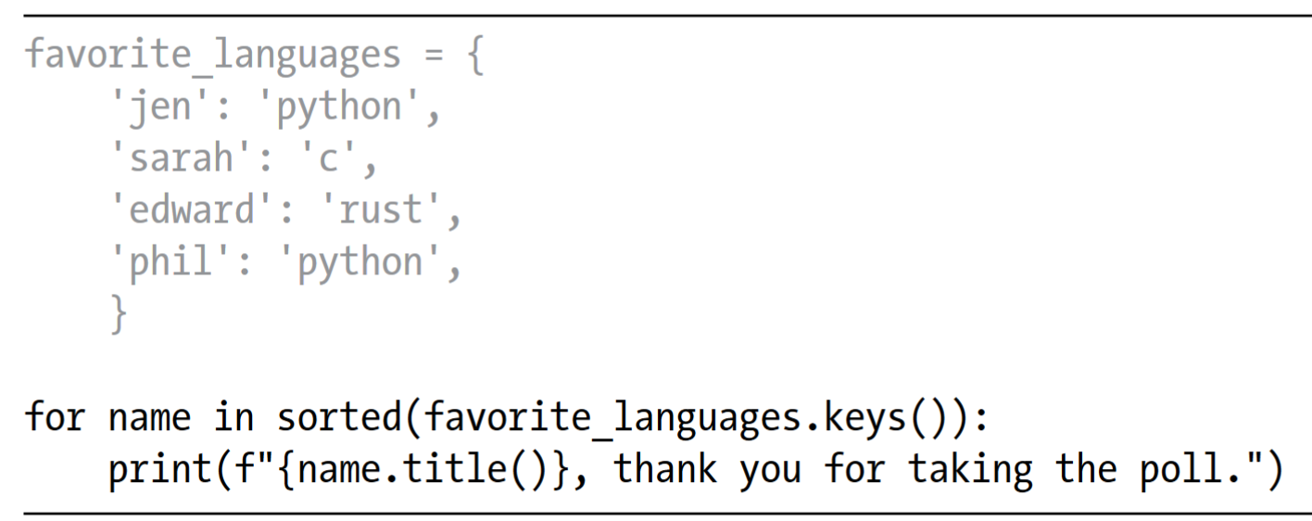
Looping Through a Dictionary’s Keys in a Particular Order
Looping through a dictionary returns the items in the same order they were inserted. Sometimes, though, you’ll want to loop through a dictionary in a different order.
One way to do this is to sort the keys as they’re returned in the for loop. You can use the sorted() function to get a copy of the keys in order

Slide 30
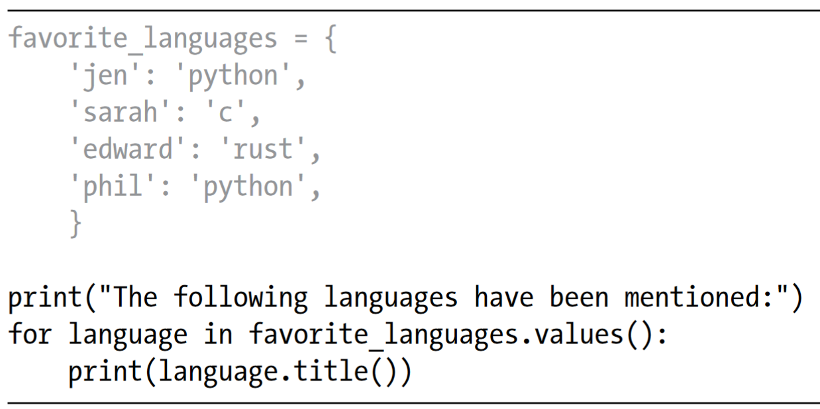
Looping Through All Values in a Dictionary
If you are primarily interested in the values that a dictionary contains, you can use the values() method to return a sequence of values without any keys.
For example, say we simply want a list of all languages chosen in our programming language poll, without the name of the person who chose each language.

Slide 31
In-class Practice
Make a dictionary containing three major rivers and the country each river runs through. One key-value pair might be 'nile': 'egypt'.
Use a loop to print a sentence about each river, such as The Nile runs through Egypt.
Use a loop to print the name of each river included in the dictionary.
Use a loop to print the name of each country included in the dictionary.

Slide 32
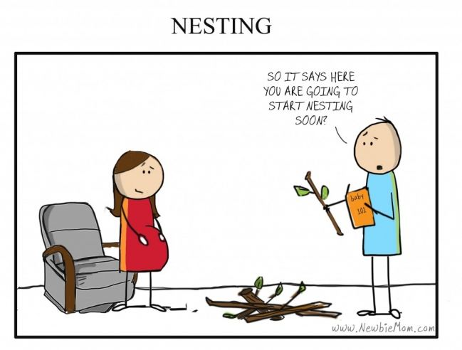
Nesting
Sometimes you’ll want to store multiple dictionaries in a list, or a list of items as a value in a dictionary. This is called nesting.
You can nest dictionaries inside a list, a list of items inside a dictionary, or even a dictionary inside another dictionary.

Slide 33
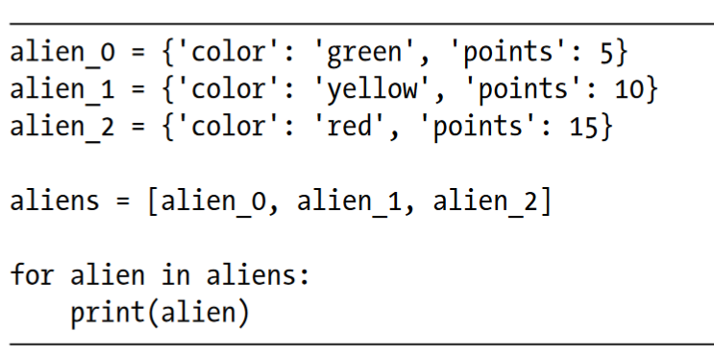
A List of Dictionaries
The alien_0 dictionary contains a variety of information about one alien, but it has no room to store information about a second alien, much less a screen full of aliens. How can you manage a fleet of aliens? One way is to make a list of aliens in which each alien is a dictionary of information about that alien.
A more realistic example would involve more than three aliens with code that automatically generates each alien.

Slide 34
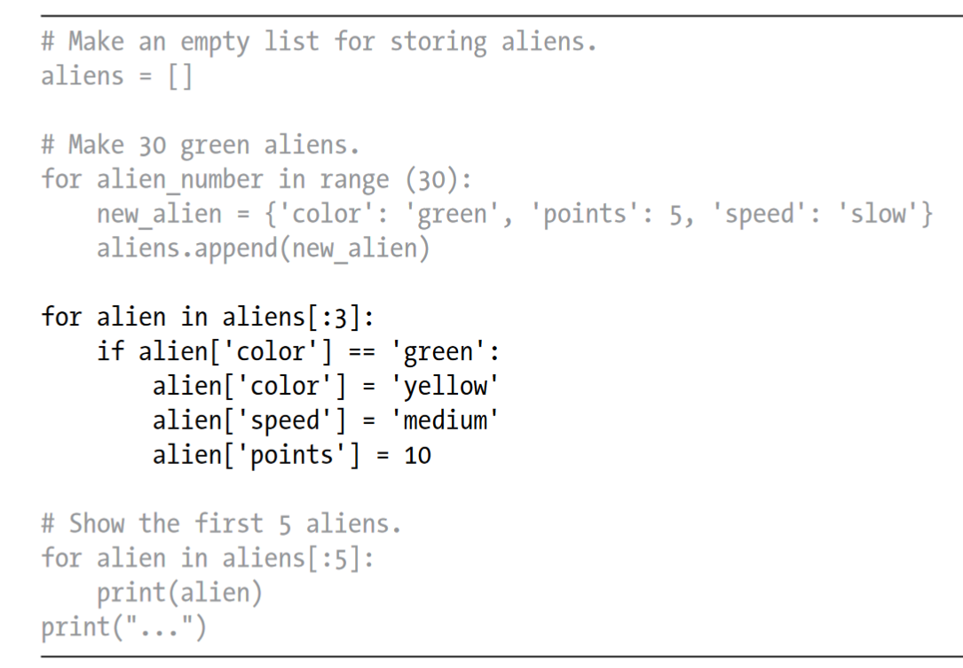
A List of Dictionaries
How might you work with a group of aliens like this? Imagine that one aspect of a game has some aliens changing color and moving faster as the game progresses. When it’s time to change colors, we can use a for loop and an if statement to change the color of the aliens.

Slide 35
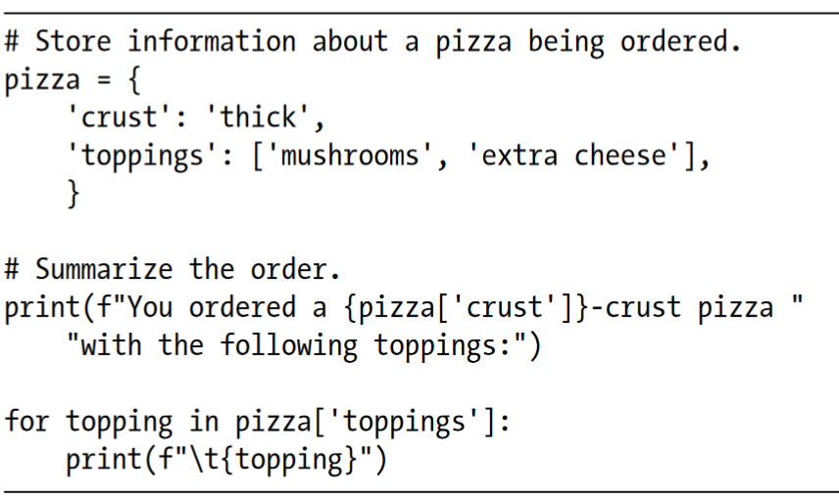
A List in a Dictionary
Rather than putting a dictionary inside a list, it’s sometimes useful to put a list inside a dictionary. For example, consider how you might describe a pizza that someone is ordering. If you were to use only a list, all you could really store is a list of the pizza’s toppings. With a dictionary, a list of toppings can be just one aspect of the pizza you’re describing.

Slide 36
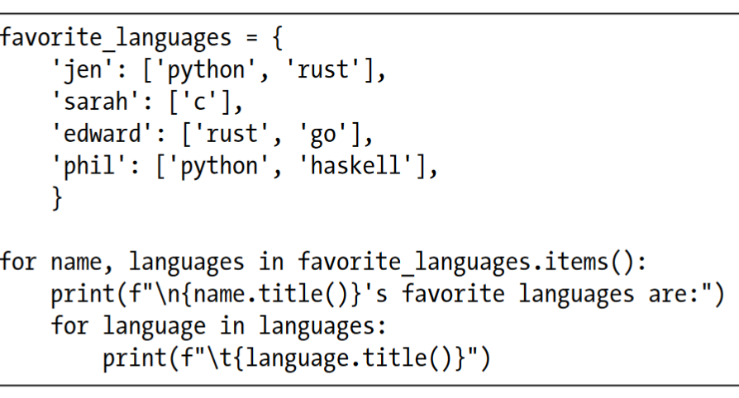
A List in a Dictionary
You can nest a list inside a dictionary anytime you want more than one value to be associated with a single key in a dictionary. In the earlier example of favorite programming languages, if we were to store each person’s responses in a list, people could choose more than one favorite language.
When we loop through the dictionary, the value associated with each person would be a list of languages rather than a single language

Slide 37
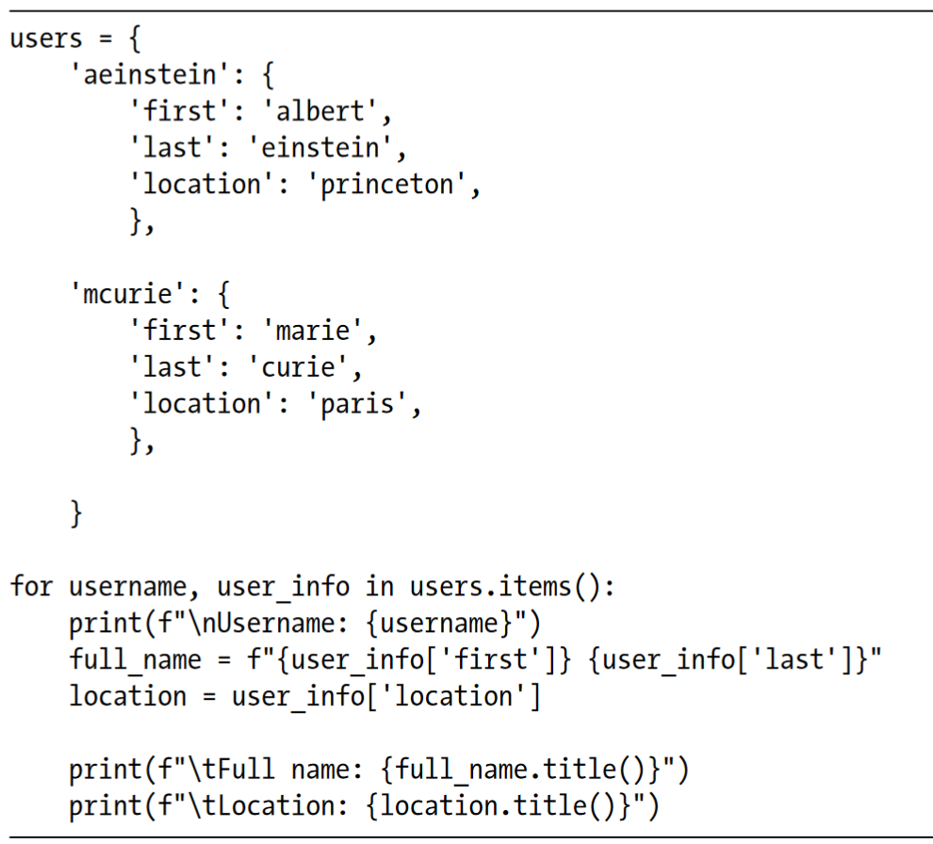
A Dictionary in a Dictionary
You can nest a dictionary inside another dictionary, but your code can get complicated quickly when you do.
For example, if you have several users for a website, each with a unique username, you can use the usernames as the keys in a dictionary. You can then store information about each user by using a dictionary as the value associated with their username.

Slide 38
Summary
In this chapter, you learned how to define a dictionary and how to work with the information stored in a dictionary.
You learned how to access and modify individual elements in a dictionary, and how to loop through all of the information in a dictionary.
You learned to loop through a dictionary’s key-value pairs, its keys, and its values.
You also learned how to nest multiple dictionaries in a list, nest lists in a dictionary, and nest a dictionary inside a dictionary.

